Slide 1
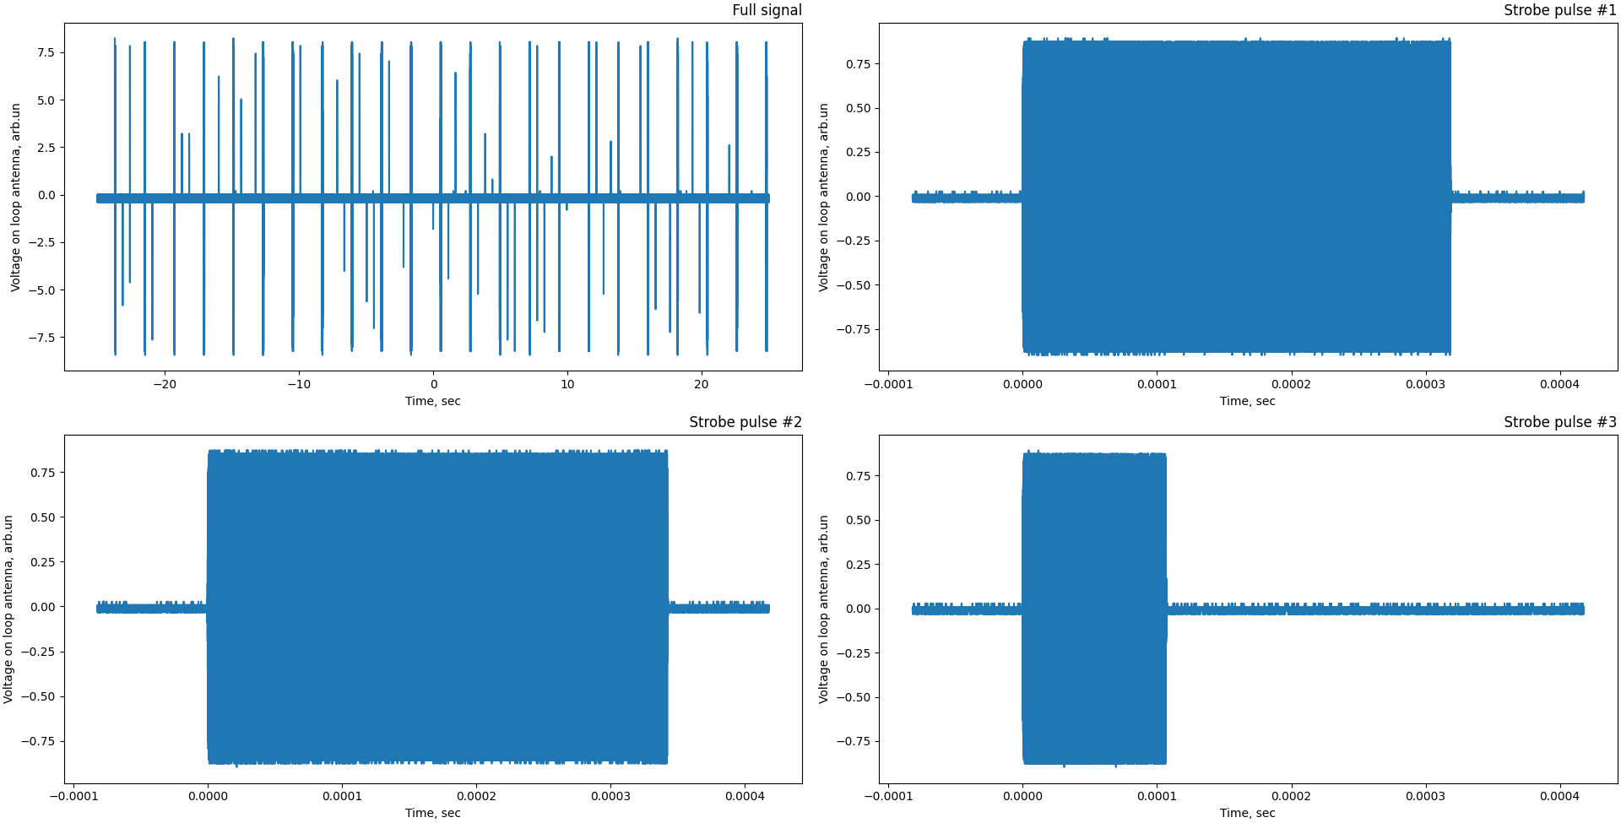
NFC Signals 13,56 МHz (phone antenna)

Slide 2
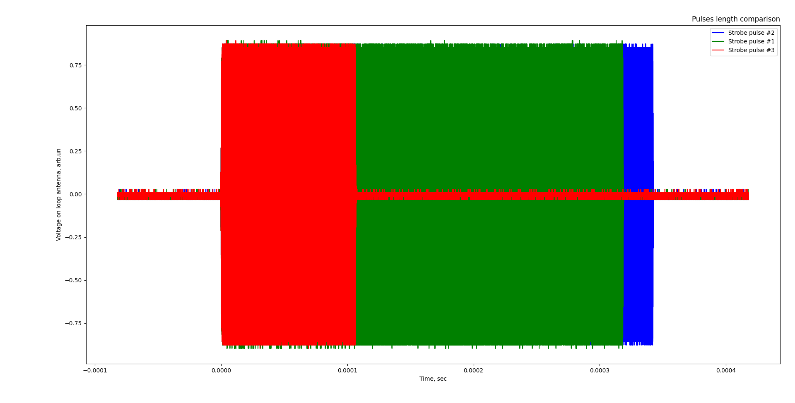
Signals have different length

Slide 3
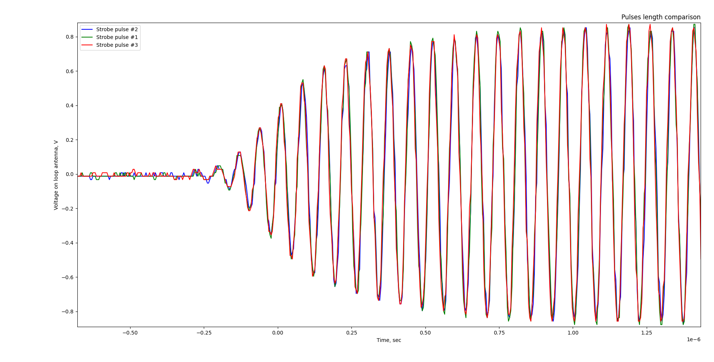
Pulses beginning
The pulses have the same shape, but differ in length.

Slide 4
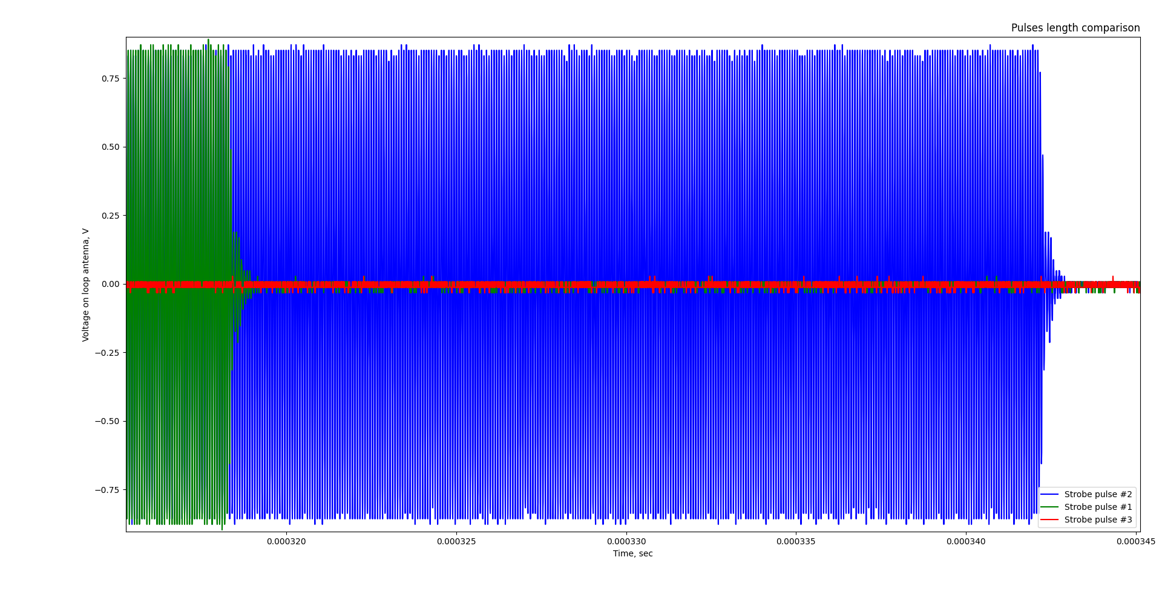
End of pulses
The difference between longest pulses approximately
30 microsecond

